Slide 1
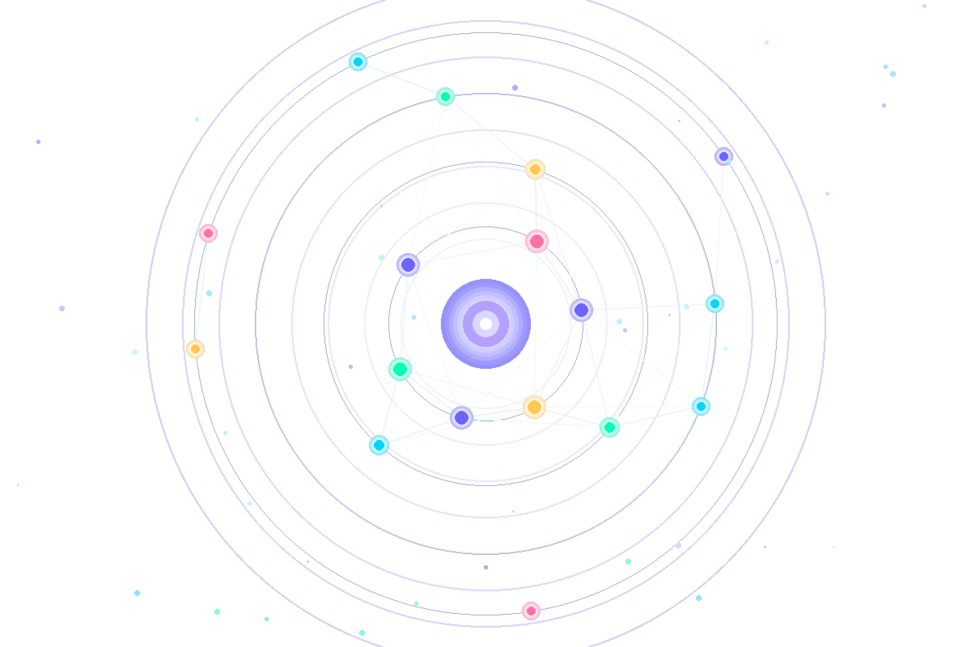
AI-POWERED CAREER PLATFORM
AURAPATH
AI
Engineering Your Destiny –
The Future of Human Potential

Slide 2
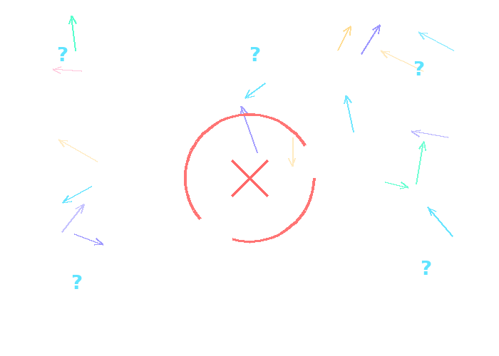
THE CHALLENGE
Why AuraPath AI Exists
01
DIRECTIONLESS AMBITION
Graduates lack data-driven navigation for global careers
RECRUITMENT FATIGUE
02
90% face black-box rejections without actionable feedback
MENTAL BURNOUT
03
No system supports psychological resilience during job hunting

Slide 3
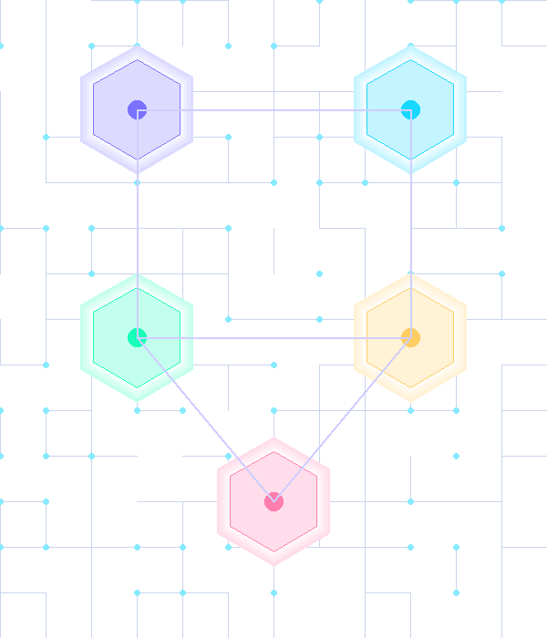
SOLUTION
AuraPath AI – A Strategic Career Intelligence Ecosystem
Transforms job hunting into a data-driven mission
N
Z
O
P
V
NEXUS
ZEN
ORBIT
PATHFINDER
VOICE & ACCESSIBILITY
Precision CV Intelligence
Psychological Fortitude
Strategic Mission Control
Market Alignment
Global Reach Layer
• Technical audit of tech stacks
• Builds resilience & motivation
• Hiring pipeline breakdown
• AI CV scan → instant job matching
• Voice-first interaction
• Gap detection for missing skills
• Handles rejection fatigue
• 6-month roadmap
• Recommends best-fit companies
• 99+ language support
• Readiness scoring before applying
• Stoic-inspired mental strength
• Salary insights (base, bonus, equity)
• Suggests bridge roles for growth
• Inclusive, global usability

Slide 4
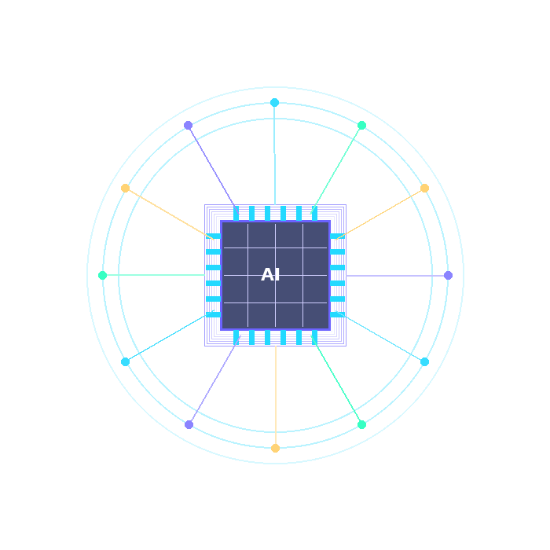
TECHNOLOGY STACK
Powered by Cutting-Edge AI Infrastructure
AI ENGINE
INFERENCE
Llama-3.3-70B
Groq
Large Language Model powering intelligent career analysis
Ultra-fast response processing for real-time interactions
VOICE LAYER
PLATFORM
Whisper-V3
Generative AI
State-of-the-art speech recognition & voice processing
Career Intelligence built on generative AI foundation
System Type: Generative AI-based Career Intelligence Platform

Slide 5
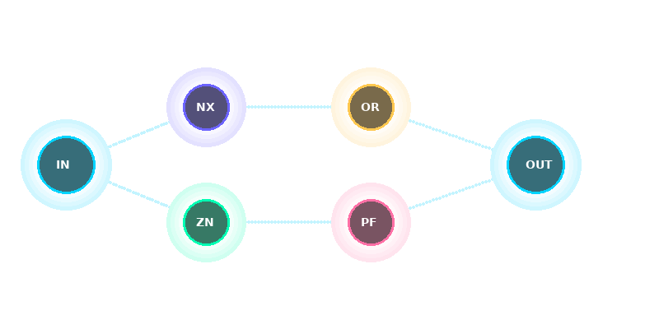
SYSTEM ARCHITECTURE
End-to-End AI Processing Flow
INPUT
AI PROCESSING
MODULES
OUTPUT
CV Upload
Llama-3.3-70B
NEXUS • ZEN
Career Strategy
▶
▶
▶
Voice Input
Groq Inference
ORBIT • PATHFINDER
Job Matches
Text Query
Whisper-V3
Growth Plan
Seamless end-to-end intelligence — from raw input to actionable career outcomes
99+
6-Month
Real-Time
100%
Languages Supported
AI Roadmap
Processing
Data-Driven

Slide 6
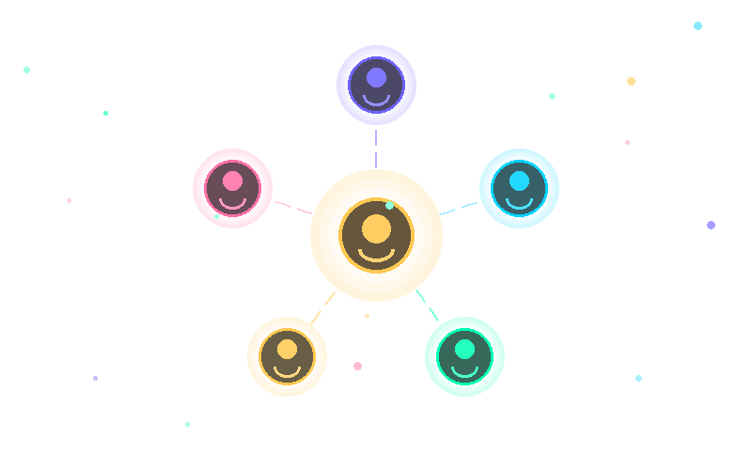
THE VISIONARY TEAM
Building the Future of Career Intelligence
TEAM LEAD
Fsc Pre Engineering
MB
Muhammad Bilal
Lead AI Architect & Logic Integration Specialist
ZK
TA
AS
HJ
AA
Zahra Khaliq
Tehreem Akhtar
Ayesha Siddiqa
Hamza Jawanda
Areej Abbas
BS Information Technology
BS Information Technology
BS Biochemistry
BS Information Technology
MS Mathematics
Research & Presentation Analyst
Research & Presentation Analyst
Demo Production & Media Specialist
Demo Production & Media Specialist
Demo Production & Media Specialist

Slide 7
AI-POWERED CAREER PLATFORM
AURAPATH
AI
DEMO VIDEO

